Slide 1
RPi > Datalogger
Instructions and software programming by Dr Richard Bruce

Slide 2
YOU WILL NEED
A Raspberry Pi 4 (RPi 4) with Pimoroni weatherHAT attached by GPIO either directly or indirectly
Note: Indirectly is better as it requires no compensation for the increased temperature produced by the RPi)
A USB-C power cable connected to mains electricity or USB battery pack
Access to a WiFi or hotspot connection
A Windows laptop or PC with the following software (Download instructions are included in the following slides):
Raspberry Pi Imager
PuTTY SSH Client
Command Prompt (Windows; already installed)

Slide 3
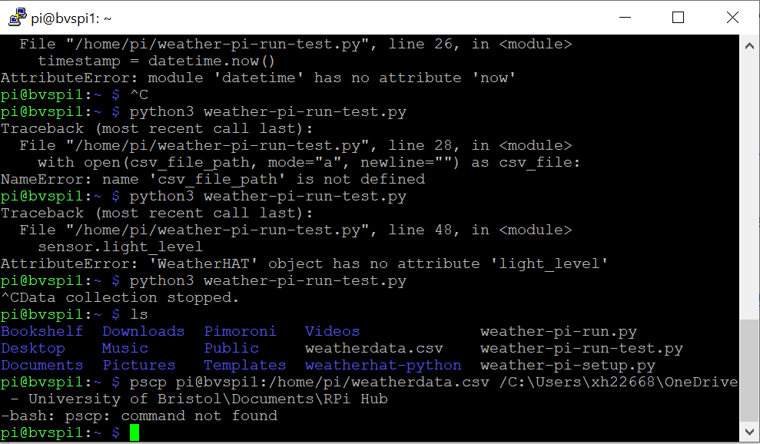
DOWNLOAD THE SSH CLIENT: PuTTY
For windows (64-bit), click this link: https://the.earth.li/~sgtatham/putty/latest/w64/putty-64bit-0.79-installer.msi
Open the file you have just downloaded and follow the recommended steps on the set up wizard
Other operating system downloads can be found here: Download PuTTY: latest release (0.79) (greenend.org.uk)

Slide 4
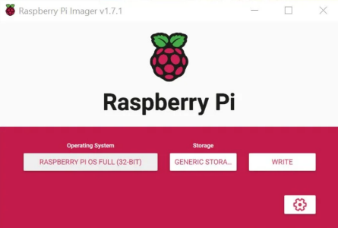
INSTALL THE RPI OS ON YOUR SD CARD
Install RPi imager via https://www.raspberrypi.com/software/ and click Download for Windows (or Mac etc.)
Plug the microSD card into your laptop
Ignore any formatting issue pop-ups
Open RPi imager
OS = RPi OS (32-bit)
Storage = the SD card you plugged in
Open RPi imager’s advanced settings by clicking the cog icon

Slide 5
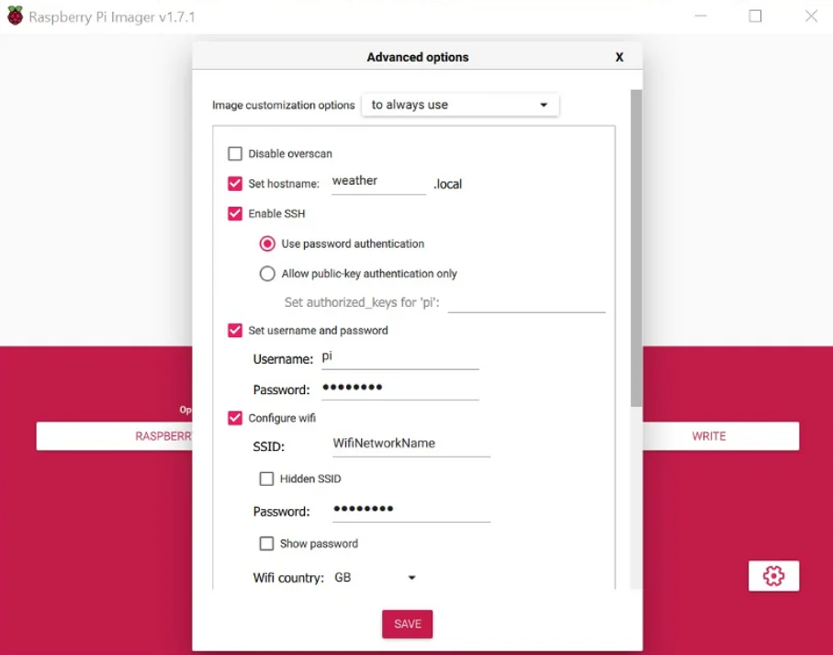
ADVANCED RPI IMAGER SETTINGS
Click the cog and copy these settings:
Hostname: bvspi[1-4] (e.g. bvspi1)
Enable SSH: Yes, use password authentification
Username: pi
Password: BVS2023 (case sensitive)
Configure Wireless Lan/Wifi:
SSID: (Enter your Wifi network ID)
For Eduroam, use Bristol-Wifi-Setup (no password; see slide 7)
Password: (Enter your home WiFi or hotspot password)
Click “Save”
Click “WRITE” and wait for it to complete

Slide 6
DOWNLOAD THE GITHUB LIBRARY
Open PuTTY and login
Type the following commands:
git clone https://github.com/DrRichBruce/PiLogger.git [enter]

Slide 7
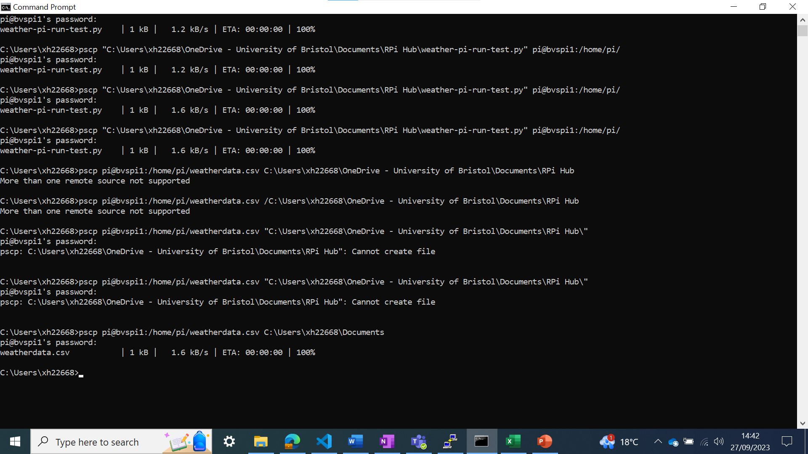
RUN THE SETUP SCRIPT
Open PuTTY
Enter device hostname: e.g. bvspi1
Click OK
Login:
Username: pi
Pssword: BVS2023
Type:
cd PiLogger (case sensitive)
python3 weather-pi-setup.py [enter]

Slide 8
RUN THE RUN SCRIPT
Open PuTTY and enter the device hostname: e.g. bvspi1 [click OK]
Login:
Username: pi
Password: BVS2023
Type the following commands:
cd PiLogger (case sensitive) [enter]
python3 weather-pi-run.py [enter]
6. Place the Datalogger in the desired place (IMPORTANT: take note of the date, time, location and orientation of each datalogger)
7. Ctrl+C or disconnect power to stop data recording
8. Transfer data file to your PC using Command Prompt on your PC:
pscp pi@bvspi1:/home/pi/weatherdata.csv C:\Users\xh22668\Documents [enter + password: BVS2023]
9. Change the filename before importing data from another RPi datalogger
(.csv files from different dataloggers will have the same name so unless the filename is changed immediately, the system will overwrite old .csv files)

Slide 9
SETUP EDUROAM NETWORK
Connect to Bristol-Wifi-Setup when using RPi Imager
Open PuTTY and login:
Hostname: bvspi[1-4] (e.g. bvspi1) [press OK]
Username: pi
Password: BVS2023 (case sensitive)
Type the following:
git clone https://github.com/DrRichBruce/PiLogger.git [enter]
cd PiLogger [enter]
Python3 eduroam-setup.py [enter + wait for device to reboot (~15 seconds)]

Slide 10
TRANSFER FILES FROM YOUR PC
Type the following into the Windows PC command line then enter Pi password (BVS2023) when prompted. Then type the following:
pscp "C:\Users\xh22668\OneDrive - University of Bristol\Documents\RPi Hub\weather-pi-setup.py" pi@bvspi1:/home/pi/ [enter] + [password prompt: BVS2023 [enter]]
pscp "C:\Users\xh22668\OneDrive - University of Bristol\Documents\RPi Hub\weather-pi-run.py" pi@bvspi1:/home/pi/ [enter] + [password prompt: BVS2023 [enter]]
However, this is part of the setup script so you don’t need to do that
(Note: not yet added to github)

